Slide 1
Introduction to JavaScript Programming With XML and PHP Creating Interactive Web Pages
Elizabeth Drake

Slide 2
Computer Basics
Chapter 0

Slide 3
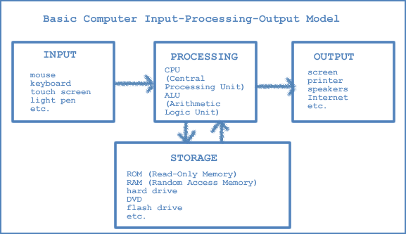
0.1
A Brief
History of Computers

Slide 4
What is a computer?
Computer: a mechanical or electronic device used to efficiently store, retrieve, manipulate large amounts of information
Analytical Engine: designed by Charles Babbage and Ada Byron in mid-1880s
ENIAC: world’s first fully operable computer, built at U of Pennsylvania by John Mauchly and Presper Eckert in 1945
Transistor: developed in late 1940s by William Schockley, John Bardeen, and Walter Brattain at Bell Labs transformed development of computers

Slide 5
0.2
A Brief History of the Internet

Slide 6
Packet Switching and TCP/IP
Packets: web pages are broken into packets which are sent to different servers
ISP: Your Internet Service Provider (ISP) requests a page, the page’s server breaks it into packets and sends them out. When received on your ISP’s server, they are reassembled and sent to your computer.
TCP: Transmission Control Protocol (TCP) breaks the web page into packets.
IP: Internet Protocol routes the packets.
IP address: Each device connected to the Internet has a unique IP address which is either static or dynamic.

Slide 7
What is a URL?
WWW: The World Wide Web (WWW or web) is a system of interlinked hypertext documents accessed via the Internet
URL: The Uniform Resource Locator (URL) is the unique address of every resource on the web
http://www.pearson.com/educator/Computer/javascrpt.htm
protocol: http Hypertext Transfer Protocol, defines the communication protocol to be used
web server: www
domain: pearson.com -- a specific organization or company
path: educator/Computer/javascrpt.htm
identifies the exact resource requested

Slide 8
0.3
Computer Basics

Slide 9
Basic input-processing-output model

Slide 10
Input
Used to receive data from the outside world
Mouse
Keyboard
Voice activation
Joysticks
Stylus
Touch screens
and more…

Slide 11
Processing
Used to receive data from the outside world
CPU: Central Processing Unit – considered the brain
ALU: Arithmetic-Logic Unit
Together they receive program instructions, perform operations to execute instructions, and control other computer components.

Slide 12
Storage
Internal Memory:
ROM: Read-Only Memory – unalterable instructions used during startup and for some other basic operations
Non-volatile (permanent)
RAM: Random Access Memory – holds data being worked on at any given time
Volatile (erased when computer is turned off)
External Memory:
Magnetic storage such as hard disks
Optical storage such as CDs and DVDs
Solid state storage such as flash (USB) drives

Slide 13
Output
Used to allow the computer to communicate with us
screens
printers
speakers
External storage
and more…

Slide 14
0.4
What is Programming?

Slide 15
Software
Programs are instructions in the computer’s memory.
Applications are programs used for many things.
Application Software:
Solves problems
Supplies information
Provides recreation
Enhances productivity
System Software:
Controls computer hardware
Communicates with the user

Slide 16
Programming and Scripting Languages
Machine languages
All 0s and 1s
Communicates only at computer level
Example:
0110 1101 1111 0111 0000 0001 0000 0000
Assembly language
Symbolic representation of machine language
Example:
ADD A, B
High-level languages
Contains English words and phrases
Must be compiled or interpreted for computer
Examples: C++, Java, Visual Basic, JavaScript

Slide 17
Programming and Scripting Languages
Programming languages are compiled
A compiler works before the program is executed
Example: C++, Java
Scripting languages are interpreted
An interpreter works while the program is running
Example: JavaScript

Slide 18
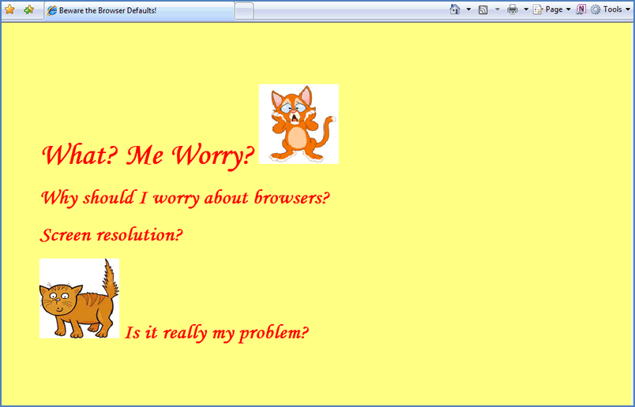
0.5
Browsers

Slide 19
What is a browser?
A browser is a software application that is used to retrieve and display information fro the web
Uses the client/server model
Your computer is the client
The place where the page you request “lives” is the server

Slide 20
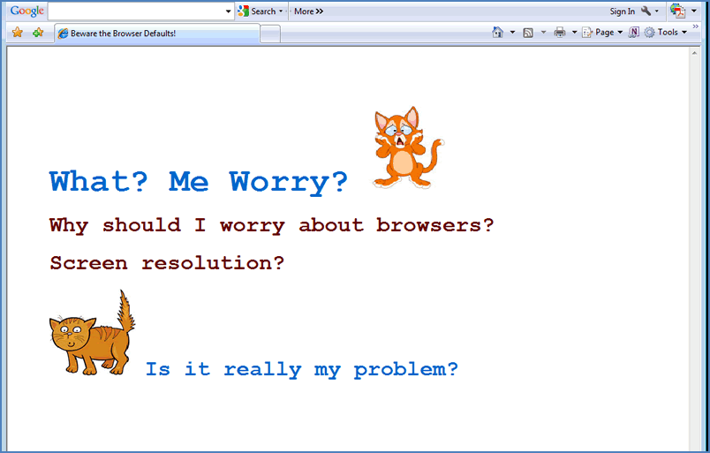
The settings a user puts on a browser can drastically change how a web page is viewed.

Slide 21
0.6
JavaScript and the Acronyms: XHTML, DOM, PHP, XML

Slide 22
Web Pages and XHTML
HTML: HyperText Markup Language
Elements: consist of opening (<) and closing (>) tags
XHTML elements must be properly nested
XHTML elements must always be closed
XHTML elements must be in lowercase
XHTML documents must have one root element

Slide 23
JavaScript
Used to make web pages dynamic (interactive with the user)
A dynamic programming language
executes at runtime
Contains first-class functions
supports passing functions as arguments to other functions, returns them as values from other functions, assigns them to variables, or stores them in data structures
A multi-paradigm language
Allows for greater flexibility

Slide 24
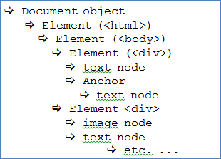
Overview of DOM
DOM: Document Object Model
DOM tree: the hierarchical structure of how tags are rendered
Example: <h1> tags are a higher level than <p> tags

Slide 25
Overview of PHP
PHP: PHP Hypertext Preprocessor
A server-side scripting language
Similar to Microsoft’s ASP (Active Server Pages)
The server generates the web page that results from the PHP processor

Slide 26
Overview of XML
XML: Extensible Markup Language
Designed to transport and store data
Uses tags like HTML
Example:
<customer>
<name>Sally Smith</name>
<greeting>Final Notice!</greeting>
<message>Please remit your balance immediately</message>
</customer>

